Slide 1

Edge-based Image Super-Resolution
Yunhan Hu, Ruohui Wang, Xin Yuan

Slide 2
01 | Single Image Super-Resolution
02 | Applications
03 | State-of-the-Art
04 | Edge-based SRGAN
05 | Results and Comparison
06 | Discussion

Slide 3

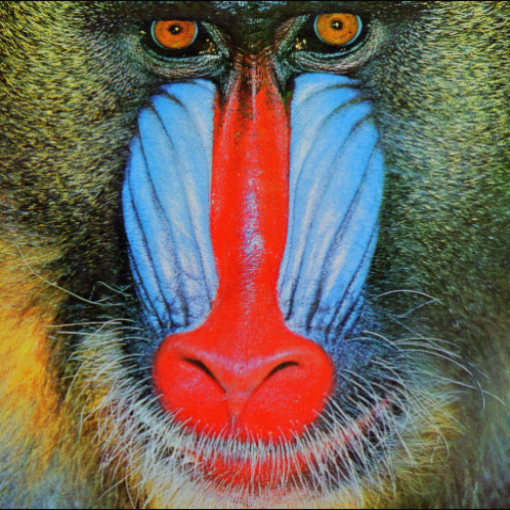
Single Image Super-Resolution
SR
Low resolution
High resolution
Notes:
Image super-resolution is the task of generating high-resolution images from low-resolution images. Due to the limitations of some actual scenes, only one low-resolution image is often available. Super-resolution using only one low-resolution image is single-image super-resolution. Since one low-resolution image corresponds to several high-resolution images, super-resolution is an ill-defined problem. Therefore, additional prior knowledge is needed to constrain the recovered high-frequency information. The state-of-the-art methods are based on deep learning. Specifically, it uses the similarity of different images in high-frequency details to obtain the relationship between high-resolution and low-resolution images to guide the reconstruction of high-resolution images.

Slide 4
Applications
Regular video information enhancement
Surveillance
Medical diagnosis
Earth-observation remote sensing
Astronomical observation
Biometric information identification
Notes:
In addition to being a research direction in computer vision, super-resolution also has many practical applications. For example, video enhancement can repair some old videos. Various medical imaging is limited by physical conditions and radiation safety, and the resolution cannot be increased arbitrarily. In this case, super-resolution can improve the quality of medical images. Similarly, remote sensing and astronomical observations are limited by the optical diffraction limit, and the resolution is difficult to improve, so super-resolution can also be used.

Slide 5
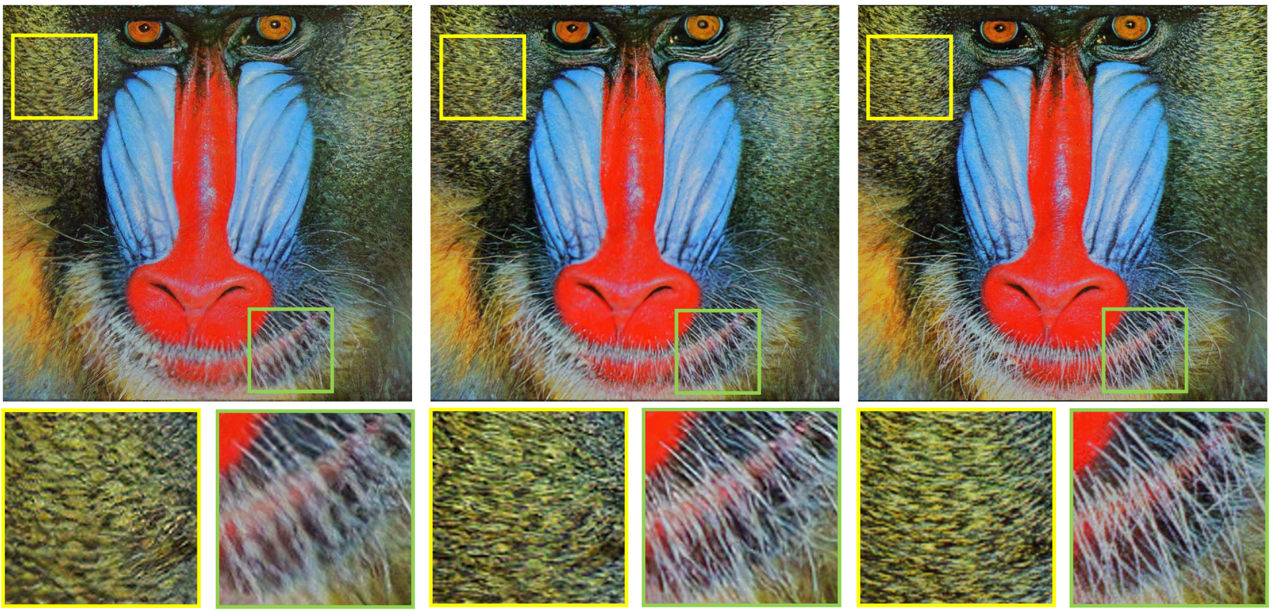


State-of-the-Art
Model | PSNR | SSIM
Bicubic | 28.43 | 0.8211
ESRGAN | 32.73 | 0.9011
EDSR | 32.46 | 0.8968
SAN | 32.70 | 0.9013
SRGAN
ESRGAN
Ground Truth
ESRGAN
Ground Truth
Notes:
The state-of-the-art super-resolution models are based on deep neural networks. Here, we list the measurement results of the three models, enhanced Super-Resolution Generative Adversarial Networks, Enhanced Deep Residual Networks, Second-Order Attention Network and the basic method, bicubic interpolation. The dataset is set5. The measurement standard uses PSNR and SSIM. PSNR is the peak signal-to-noise ratio, which represents the pixel similarity between the super-resolution image and the original image. SSIM is structural similarity. Compared with PSNR, structural similarity is more in line with the human eye's judgment of image quality.
Based on the figure from the paper, the state of art method, ESRGAN, looks very good, even for recovering the fine features, like whiskers. However, it still shows obvious distortion for some regions that are supposed to contain some well-defined structures. For example, when we apply the ESRGAN on the figure on the left, we can see the blur and distortion of the edge.

Slide 6
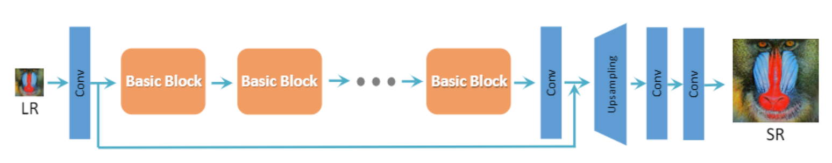

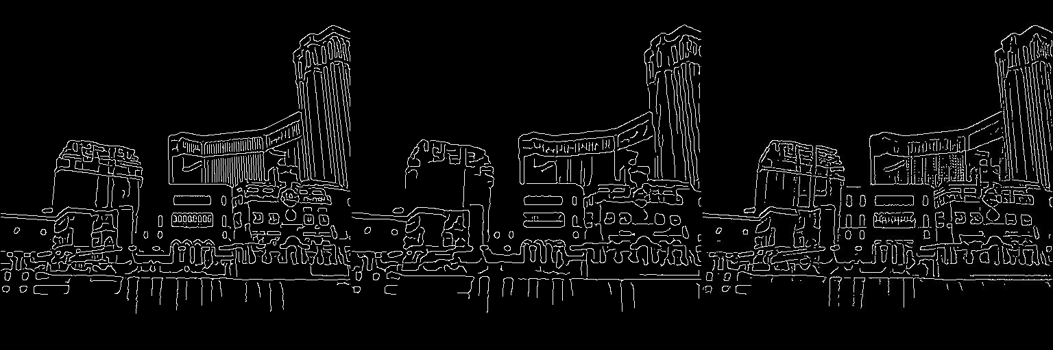
Edge-based SRGAN
SRResNet
GAN1
Predicted
SR_edge
LR
GAN2
SR
LR
Notes:
One possible reason can be, the network may not realize there should be a sharp edge. For most the SR networks, we only directly feed in the LR image, and let the network learn everything. It can be possible that the network implicitly learns when and where to ‘make an edge’, but what if we let it explicitly learn and utilize the edge information?
So, in our proposed work, we first let a GAN to recover the high resolution edge information from a LR image, we can call it SR edge. Then, we feed this SR_edge along with LR image, to inpaint an SR image.

Slide 7


4x SR edge prediction
HR
（σ=1.6）
Bicubic
（σ=1.6）
Ours
$$Recall=\frac{\#P correctly predicted }{\#P on GT}$$
Input
$$Precision=\frac{\#P correctly predicted }{\#P been predicted}$$
Model | Recall | Precision
Bicubic_canny (optimized sigma) | 0.529 | 0.472
Ours | 0.618 | 0.552
Output
Notes:
Here’s the result for the edge part. The recall and precision are the percentage correctness compared to the ground truth and pixel predicted. The SR_edge information can also be directly extracted from bicubic upsmapled image. It turns out that our network shows obviously better result even compared to the optimized canny edge detection.
On the right, we can see that the trivial method using canny edge detection fail to recover the straight line, while our network can predict the straight edge same as edge from HR image. We can also see that the edge predicted from our network is closer to the edge generated from HR image.

Slide 8
Results and Comparison
Model | PSNR | SSIM
Bicubic | 25.99 | 0.7031
SRCNN | 27.50 | 0.7513
SRGAN | 26.02 | 0.7397
Ours | 25.19 | 0.9134
Notes:
This is the result of our network evaluation. The testing set is set 14. Downsampling is 4 times. The results show that the PSNR is low. This is because the loss function of our network is not PSNR-oriented, and the network has not fully converged due to limited computing power. SSIM is very high. This is normal because we use edge images, which is equivalent to inputting structural information into the network.

Slide 9





Results and Comparison
Ground Truth
Bicubic
SRCNN
SRGAN
Ours
Notes:
These images are ground truth, bicubic, SRCNN, SRGAN and our network. As a result, our image is better than bicubic and SRCNN, and is close to the result of SRGAN. However, our pictures have chromatic aberration and noise, which is why the PSNR is low.

Slide 10
Discussion

Slide 11
THANK YOU

